Slide 1
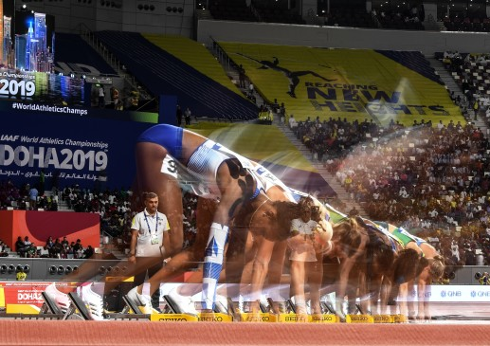
Попека Вера Алексеевна
«Анализ выступления белорусских легкоатлетов на Чемпионате мира 2019, перспективы завоевания наград на Олимпийских играх 2020 »
Научный руководитель: Юшкевич Т.П., доктор пед. наук, профессор

Slide 2
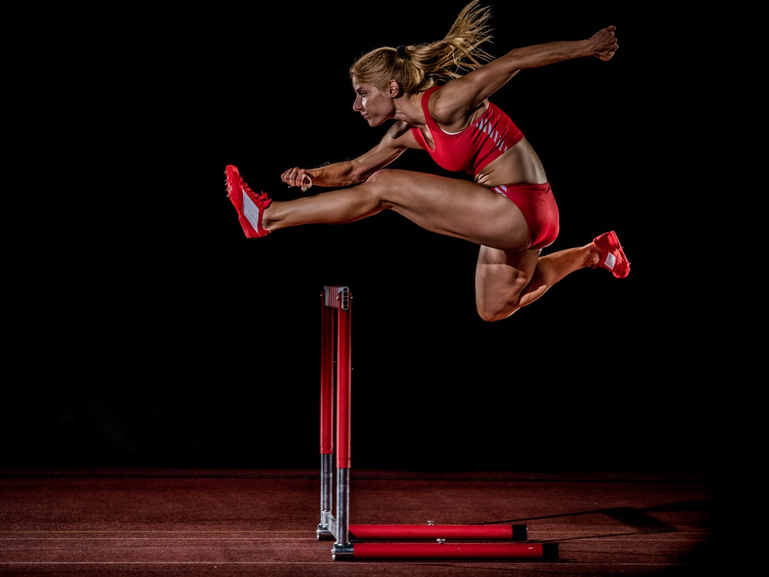
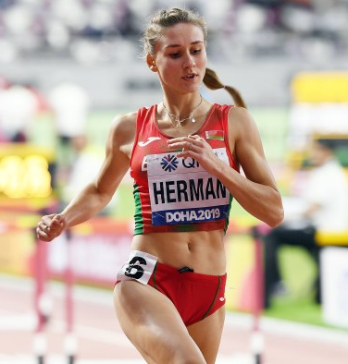
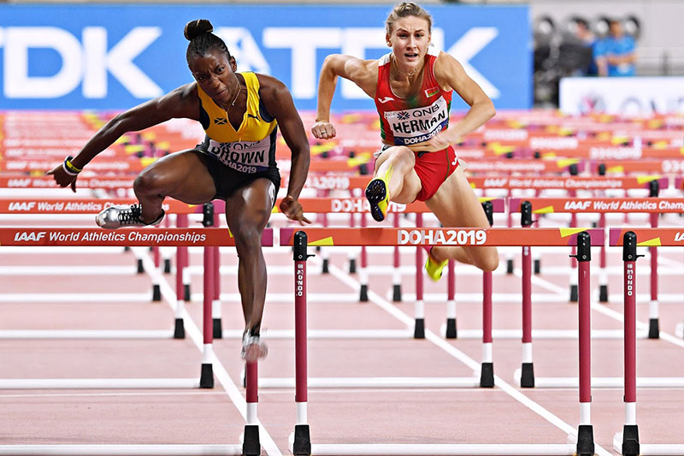
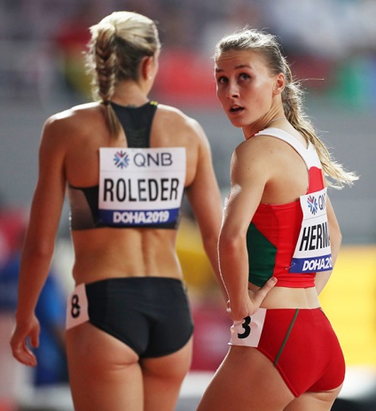
Барьерный бег 100м

Slide 3
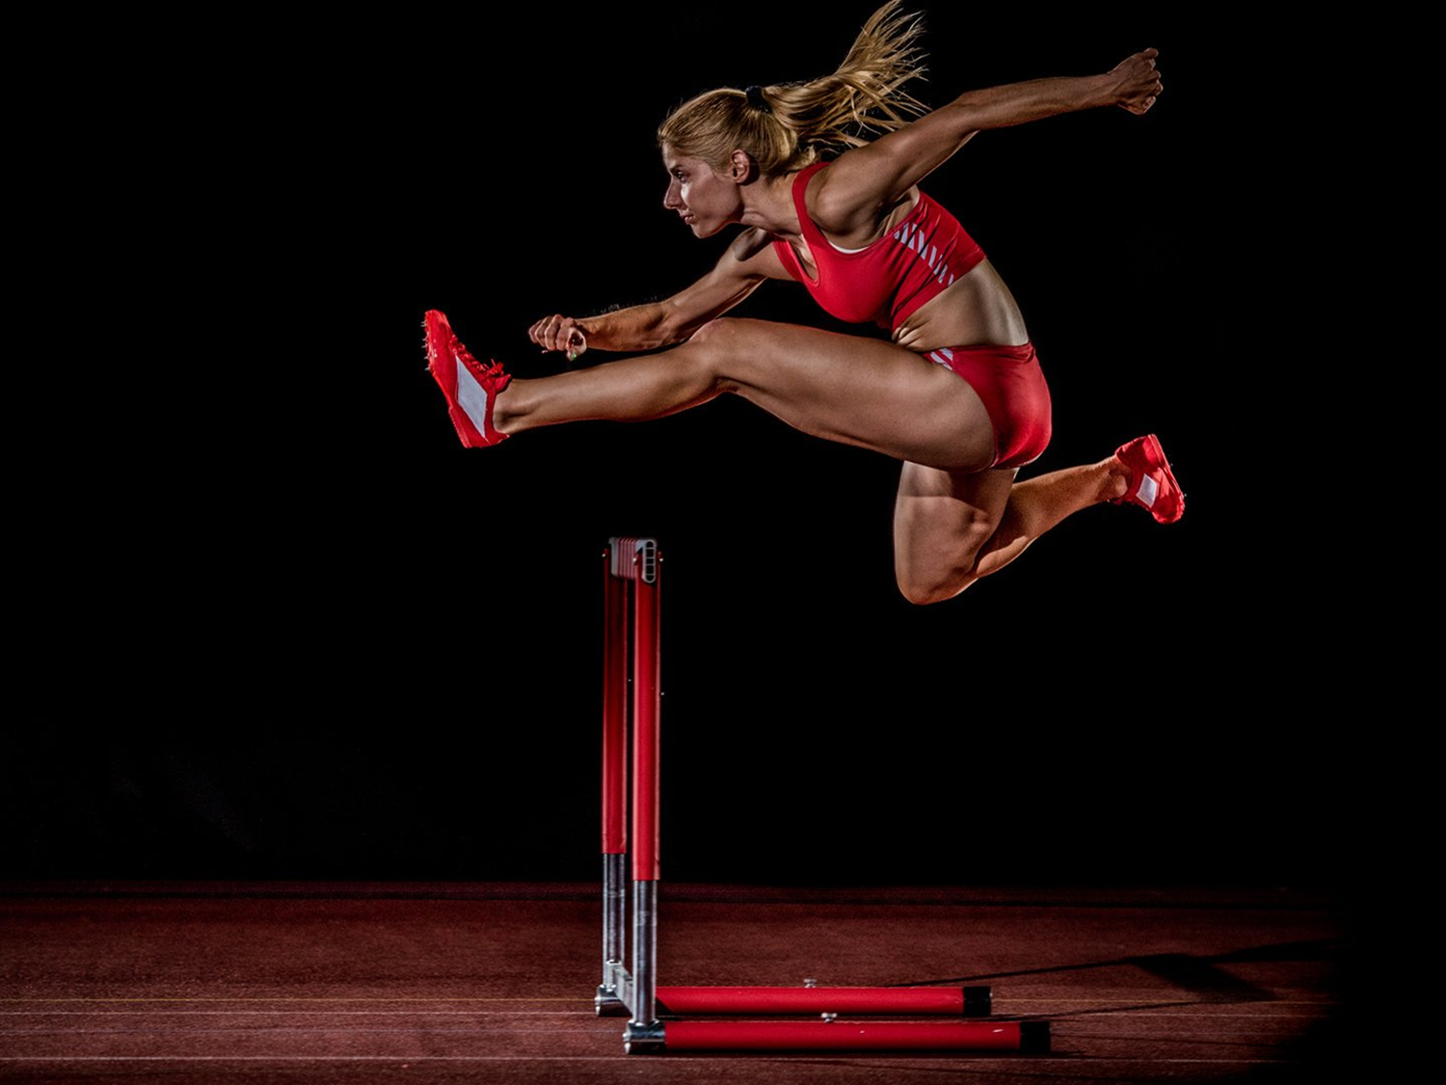
ТОП 10 результатов мира за все время:
Rank | Time | Wind | Competitor | DOB | NAT | POS | Venue | Date | RESULTS SCORE
1 | 12.20 | +0.3 | KENDRA HARRISON | 18 SEP 1992 | USA | 1 | Olympic Stadium, London (GBR) | 22 JUL 2016 | 1261
2 | 12.21 | +0.7 | YORDANKA DONKOVA | 28 SEP 1961 | BUL | 1 | Stara Zagora (BUL) | 20 AUG 1988 | 1259
3 | 12.25 | +1.4 | GINKA ZAGORCHEVA | 12 APR 1958 | BUL | 1 | Drama (GRE) | 08 AUG 1987 | 1253
4 | 12.26 | +1.7 | LYDMILA NAROZHILENKO | 21 APR 1964 | RUS | 1f1 | Sevilla (ESP) | 06 JUN 1992 | 1252
4 | 12.26 | +1.2 | BRIANNA MCNEAL | 18 AUG 1991 | USA | 1 | Drake Stadium, Des Moines, (USA) | 22 JUN 2013 | 1252
6 | 12.28 | +1.1 | SALLY PEARSON | 19 SEP 1986 | AUS | 1 | DS, Daegu (KOR) | 03 SEP 2011 | 1249
7 | 12.32 | +0.8 | DANIELLE WILLIAMS | 14 SEP 1992 | JAM | 1 | Olympic Stadium, London (GBR) | 20 JUL 2019 | 1244
8 | 12.33 | -0.3 | GAIL DEVERS | 19 NOV 1966 | USA | 1 | Sacramento, CA | 23 Jul 2000 | 1243
9 | 12.34 | +1.9 | SHARIKA NELVIS | 10 MAY 1990 | USA | 1h3 | Eugene (Hayward Field), OR | 26 Jun 2015 | 1241
9 | 12.34 | +0.3 | NIA ALI | 23 Oct 1988 | USA | 1 | Doha | 6 Oct 2019 | 1241

Slide 4
ТОП 10 результатов в 2019г :
RANK | RESULT | WIND | COMPETITOR | DOB | NAT | POS | VENUE
1 | 12.32 | +0.8 | DANIELLE WILLIAMS | 14 SEP 1992 | JAM | 1 | London (GBR)20 Jul
2 | 12.34 | +0.3 | NIA ALI | 23 Oct 1988 | USA | 1 | Doha6 Oct
3 | 12.40 | +0.6 | JANEEK BROWN | 14 MAY1998 | JAM | 1 | Austin, TX (USA)8 Jun
4 | 12.43 | +0.1 | KENDRA HARRISON | 18 SEP 1992 | USA | 1 | Monaco (MON)12 Jul
5 | 12.48 | +0.2 | TODI AMUSAN | 23 APR 1997 | NGR | 1 | Doha 5 Oct
6 | 12.52 | +0.6 | CHANEL BRISSET | 10 AUG1999 | USA | 2 | Austin, TX (USA)8 Jun
7 | 12.57 | +1.7 | TONEAL MARSHALL | 17 DEC 1998 | USA | 1 | Queretaro (MEX)6 Jul
8 | 12.58 | +1.8 | CHRISTINA CLEMONS | 29 MAY1990 | USA | 1h1 | Turku (FIN)11 Jun
8 | 12.58 | +0.4 | KENDELL WILLIAMS | 14 JUN 1995 | USA | 1ce3 | Doha2 Oct
10 | 12.61 | -1.2 | BRIANNA MCNEAL | 18 AUG 1991 | USA | 3 | Des Moines, IA (USA)27 Jul
10 | 12.61 | +0.8 | MEGAN TAPPER | 18MAR1994 | JAM | 2h2 | Doha 6 Oct
20 | 12.70 | +1.8 | ELVIRA HERMAN | 19 JUN 1997 | BLR | 1 | Gävle (SWE)

Slide 5
ТОП 10 результатов В БРИЛЛИАНТОВОЙ ЛИГЕ :
POS | ATHLETE | NAT | RESULT | DATE
1 | DANIELE WILLIAMS | JAM | 12.32 | 20.07.2019
2 | KENDRA HARRISON | USA | 12.43 | 12.07.2019
3 | NIA ALI | USA | 12.57 | 20.07.2019
4 | CHRISTINA CLEMONS | USA | 12.62 | 12.07.2019
5 | QUEEN CLAYE | USA | 12.64 | 20.07.2019
6 | MEGAN TAPPER | JAM | 12.66 | 20.10.2019
7 | SHARIKA NELVIS | USA | 12.69 | 30.05.2019
8 | JANEEK BROWN | JAM | 12.71 | 12.07.2019
8 | TOBI AMUSAN | NGR | 12.71 | 18.08.2019
10 | ELVIRA HERMAN | BLR | 12.84 | 13.06.2019

Slide 6
ТОП 10 результатов финала Чемпионата мира 2019 г( 06.10.2019):
POS | BIB | ATHLETE | NAT | RESULT | REACTION TIME | WIND
1 | 1942 | NIAi ALI | USA | 12.34 PB | 0.155 | +0.3m/s
2 | 1974 | KENDRA HARRISON | USA | 12.46 | 0.140
3 | 1204 | DANIELLE WILLIAMS | JAM | 12.47 | 0.127
4 | 1462 | TODI AMUSAN | NGR | 12.49 | 0.218
5 | 549 | ANDREA CAROLINA VARGAS | CRC | 12.64 NR | 0.157
6 | 1445 | NADINE VISSER | NED | 12.66 | 0.147
7 | 1176 | JANEEK BROWN | JAM | 12.88 | 0.147
 | 1200 | MEGAN TAPPER | JAM | DNF | 0.209

Slide 7
Динамика индивидуальных результатов сильнейших спортсменов в олимпийском цикле (главные старты):
Рисунок 1 – Ниа Али (США)
Рисунок 2 – Кендра Харрисон (США)

Slide 8
Рисунок 3 – Даниэль Уильямс (Ямайка)
Рисунок 4 – Эльвира Герман (Беларусь)

Slide 9
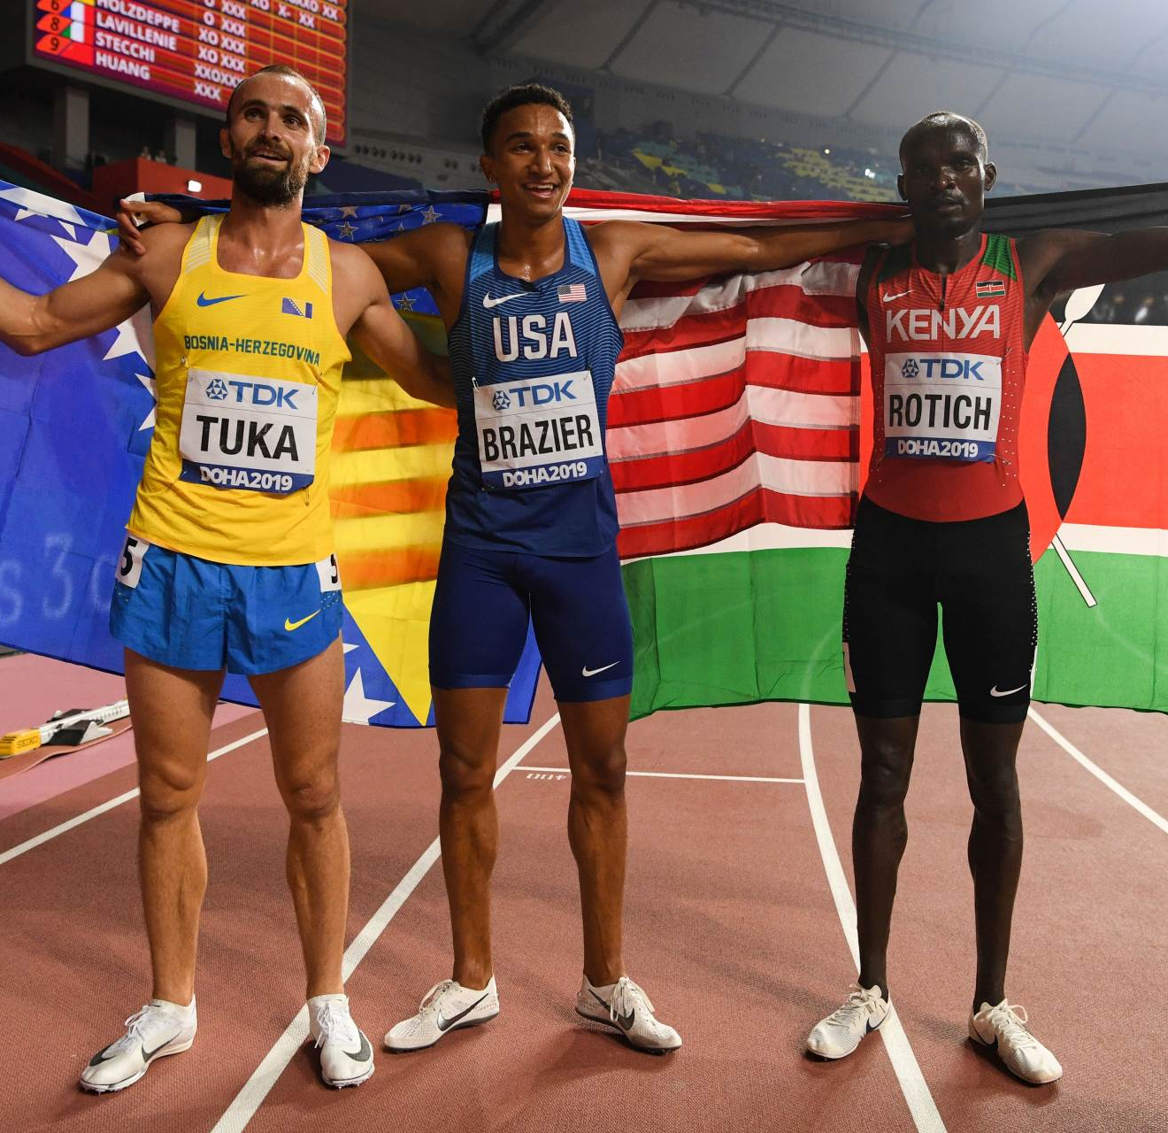
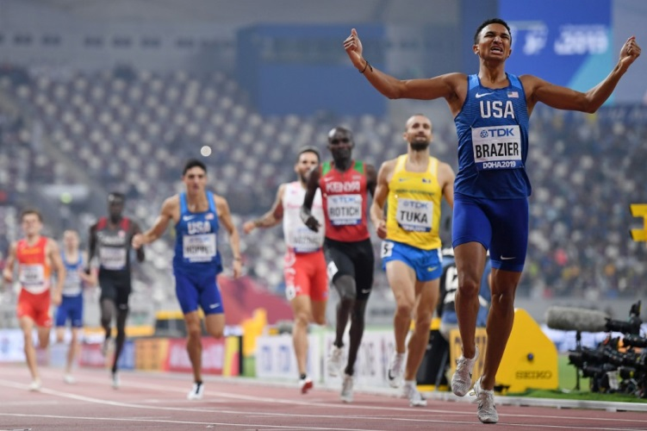
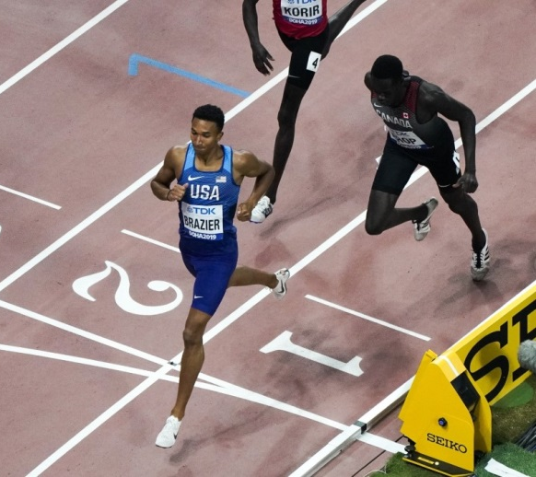
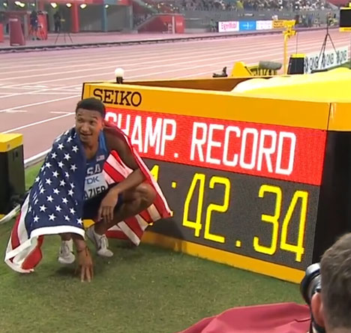
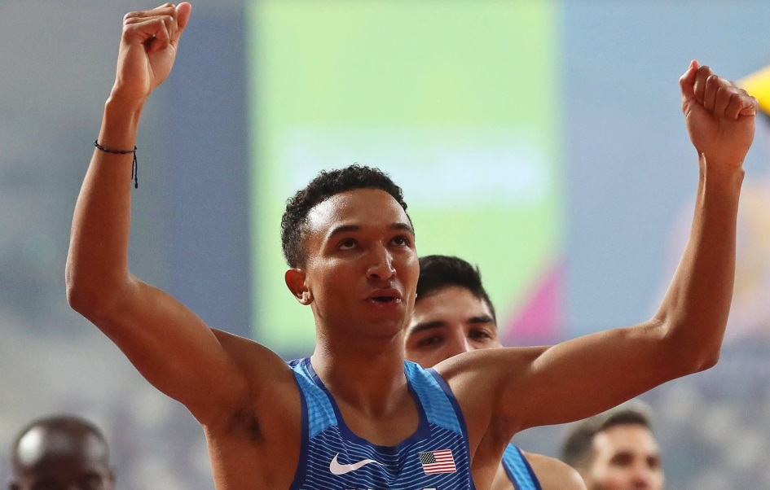
Бег 800 м. (МУЖ).

Slide 10
ТОП 10 результатов мира за все время:
RANK | MARK | COMPETITOR | DOB | NAT | POS | VENUE | DATE | RESULTS SCORE
1 | 1:40.91 | David RUDISHA | 17 DEC 1988 | KEN | 1 | Olympic Stadium, London (GBR) | 09 AUG 2012 | 1301
2 | 1:41.11 | Wilson KIPKETER | 12 DEC 1972 | DEN | 1 | Köln (GER) | 24 AUG 1997 | 1295
3 | 1:41.73 | Sebastian COE | 29 SEP 1956 | GBR | 1 | Firenze (ITA) | 10 JUN 1981 | 1275
3 | 1:41.73 | Nijel AMOS | 15MAR 1994 | BOT | 2 | Olympic Stadium, London (GBR) | 09 AUG 2012 | 1275
5 | 1:41.77 | Joaquim CRUZ | 12MAR 1963 | BRA | 1 | Köln (GER) | 26 AUG 1984 | 1274
6 | 1:42.05 | Emmanuel Kipkurui KORIR | 15 JUN 1995 | KEN | 1 | Olympic Stadium, London (GBR) | 22 JUL 2018 | 1265
7 | 1:42.23 | Abubaker KAKI | 21 JUN 1989 | SUD | 2 | Bislett, Oslo (NOR) | 04 JUN 2010 | 1259
8 | 1:42.28 | Sammy KOSKEI | 14 MAY 1961 | KEN | 2 | Köln (GER) | 26 AUG 1984 | 1258
9 | 1:42.34 | Wilfred BUNGEI | 24 JUL 1980 | KEN | 2 | Rieti (ITA) | 08 SEP 2002 | 1256
9 | 1:42.34 | Donavan BRAZIER | 15 APR 1997 | USA | 1f1 | Khalifa International Stadium, Doha (QAT) | 01 OCT 2019 | 1256

Slide 11
ТОП 10 результатов в 2019г :
RANK | MARK | COMPETITOR | DOB | NAT | POS | VENUE | DATE | RESULTS SCORE
1 | 1:40.91 | David RUDISHA | 17 DEC 1988 | KEN | 1 | Olympic Stadium, London (GBR) | 09AUG2012 | 1301
2 | 1:41.11 | Wilson KIPKETER | 12 DEC 1972 | DEN | 1 | Köln (GER) | 24AUG1997 | 1295
3 | 1:41.73 | Sebastian COE | 29 SEP 1956 | GBR | 1 | Firenze (ITA) | 10 JUN1981 | 1275
3 | 1:41.73 | Nijel AMOS | 15 MAR1994 | BOT | 2 | Olympic Stadium, London (GBR) | 09AUG2012 | 1275
5 | 1:41.77 | Joaquim CRUZ | 12 MAR1963 | BRA | 1 | Köln (GER) | 26AUG1984 | 1274
6 | 1:42.05 | Emmanuel Kipkurui KORIR | 15 JUN 1995 | KEN | 1 | Olympic Stadium, London (GBR) | 22 JUL 2018 | 1265
7 | 1:42.23 | Abubaker KAKI | 21 JUN 1989 | SUD | 2 | Bislett, Oslo (NOR) | 04 JUN2010 | 1259
8 | 1:42.28 | Sammy KOSKEI | 14 MAY 1961 | KEN | 2 | Köln (GER) | 26AUG1984 | 1258
9 | 1:42.34 | Wilfred BUNGEI | 24 JUL 1980 | KEN | 2 | Rieti (ITA) | 08 SEP2002 | 1256
9 | 1:42.34 | Donavan BRAZIER | 15 APR 1997 | USA | 1f1 | Khalifa International Stadium, Doha (QAT) | 01 OCT 2019 | 1256

Slide 12
ТОП 10 результатов В БРИЛЛИАНТОВОЙ ЛИГЕ :
POS | ATHLETE | NAT | RESULT | DATE
1 | Nijel AMOS | BOT | 1:41.89 | 12.07.2019
2 | Ferguson Cheruiyot ROTICH | KEN | 1:42.54 | 12.07.2019
3 | Donavan BRAZIER | USA | 1:42.70 | 29.08.2019
4 | Wyclife KINYAMAL | KEN | 1:43.48 | 20.07.2019
5 | Brandon MCBRIDE | CAN | 1:43.51 | 29.08.2019
6 | Amel TUKA | BIH | 1:43.62 | 12.07.2019
7 | Emmanuel Kipkurui KORIR | KEN | 1:43.69 | 29.08.2019
8 | Michael SARUNI | KEN | 1:43.70 | 12.07.2019
9 | Marcin LEWANDOWSKI | POL | 1:43.74 | 20.07.2019
10 | Wesley VÁZQUEZ | PUR | 1:43.83 | 24.08.2019

Slide 13
ТОП 10 результатов финала Чемпионата мира 2019 г( 01.10.2019):
POS | BIB | ATHLETE | NAT | MARK
1 | 1871 | Donavan BRAZIER | USA | 1:42.34 CR
2 | 272 | Amel TUKA | BIH | 1:43.47 SB
3 | 1295 | Ferguson Cheruiyot ROTICH | KEN | 1:43.82
4 | 1896 | Bryce HOPPEL | USA | 1:44.25 PB
5 | 1591 | Wesley VÁZQUEZ | PUR | 1:44.48
6 | 647 | Adrián BEN | ESP | 1:45.58
7 | 395 | Marco AROP | CAN | 1:45.78
8 | 1919 | Clayton MURPHY | USA | 1:47.84

Slide 14
Динамика индивидуальных результатов сильнейших спортсменов в олимпийском цикле (главные старты):
Рисунок 1 –Донован Брейзер (США)
Рисунок 2 – Амель Тука (Босния)

Slide 15
Рисунок 3 – Фергюсон Черуйот Ротич (Кения)

Slide 16
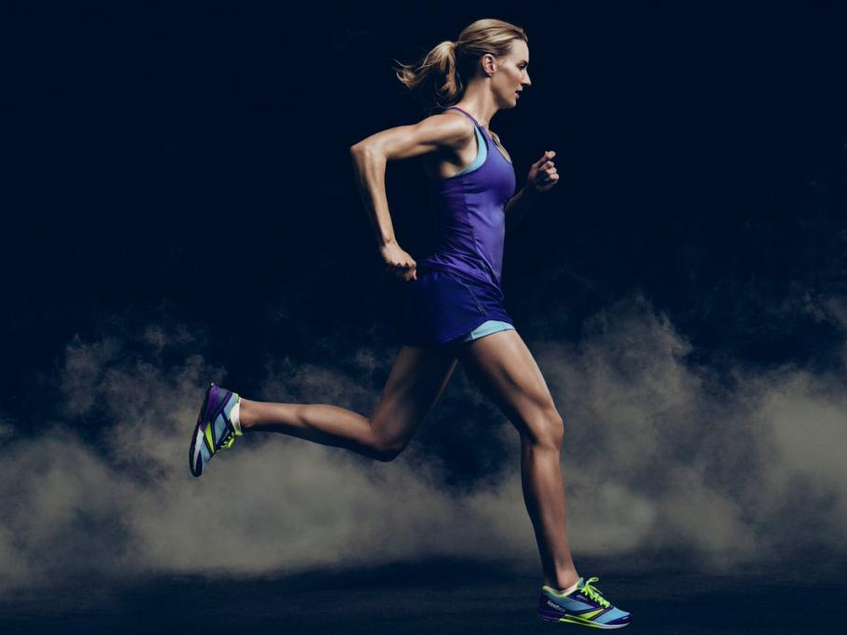
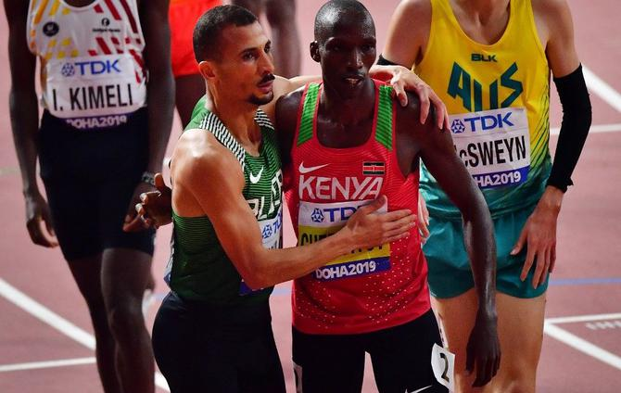
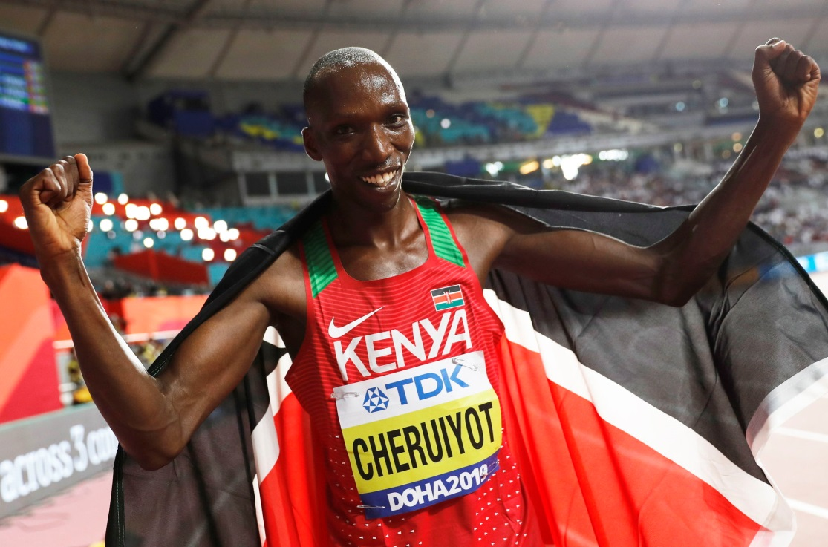
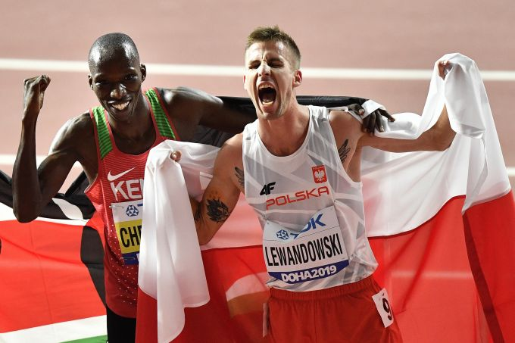
Бег 1500 м. (МУЖ)

Slide 17
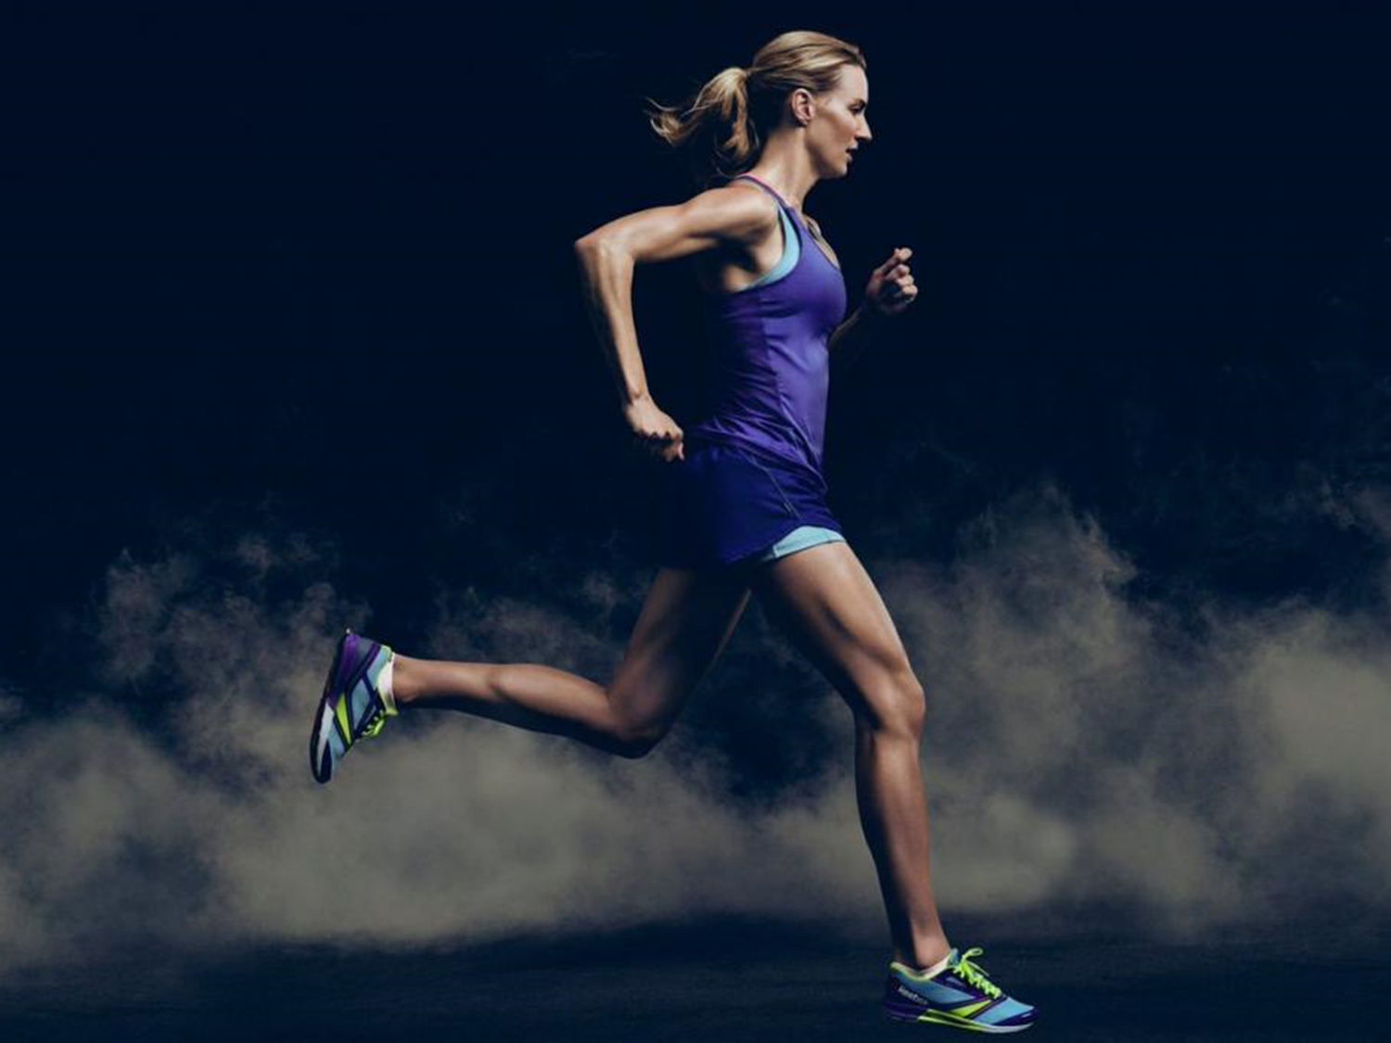
ТОП 10 результатов мира за все время:
RANK | MARK | COMPETITOR | DOB | NAT | POS | VENUE | DATE | RESULTS SCORE
1 | 3:26.00 | Hicham EL GUERROUJ | 14 SEP 1974 | MAR | 1 | Stadio Olimpico, Roma (ITA) | 14 JUL 1998 | 1302
2 | 3:26.34 | Bernard LAGAT | 12 DEC 1974 | KEN | 2 | Bruxelles (BEL) | 24 AUG 2001 | 1297
3 | 3:26.69 | Asbel KIPROP | 30 JUN 1989 | KEN | 1 | Stade Louis II, Monaco (MON) | 17 JUL 2015 | 1292
4 | 3:27.37 | Noureddine MORCELI | 28 FEB 1970 | ALG | 1 | Nice (FRA) | 12 JUL 1995 | 1282
5 | 3:27.64 | Silas KIPLAGAT | 20 AUG 1989 | KEN | 1 | Stade Louis II, Monaco (MON) | 18 JUL 2014 | 1279
6 | 3:28.12 | Noah NGENY | 02 NOV 1978 | KEN | 2f1 | Zürich (SUI) | 11 AUG 2000 | 1272
7 | 3:28.41 | Timothy CHERUIYOT | 20 NOV 1995 | KEN | 1 | Stade Louis II, Monaco (MON) | 20 JUL 2018 | 1267
8 | 3:28.75 | Taoufik MAKHLOUFI | 29 APR 1988 | ALG | 2 | Stade Louis II, Monaco (MON) | 17 JUL 2015 | 1263
9 | 3:28.79 | Abdelaati IGUIDER | 25 MAR 1987 | MAR | 3 | Stade Louis II, Monaco (MON) | 17 JUL 2015 | 1262
10 | 3:28.80 | Elijah Motonei MANANGOI | 05 JAN 1993 | KEN | 1 | Stade Louis II, Monaco (MON) | 21 JUL 2017 | 1262

Slide 18
ТОП 10 результатов в 2019г :
RANK | MARK | COMPETITOR | DOB | NAT | POS | VENUE | DATE | RESULTS SCORE
1 | 3:28.77 | Timothy CHERUIYOT | 20 NOV 1995 | KEN | 1 | Pontaise, Lausanne (SUI) | 05 JUL 2019 | 1262
2 | 3:30.16 | Jakob INGEBRIGTSEN | 19 SEP 2000 | NOR | 2 | Pontaise, Lausanne (SUI) | 05 JUL 2019 | 1242
3 | 3:30.58 | Ronald MUSAGALA | 16 DEC 1992 | UGA | 3 | Stade Louis II, Monaco (MON) | 12 JUL 2019 | 1236
4 | 3:30.62 | Charlie DA'VALL GRICE | 07 NOV 1993 | GBR | 4 | Stade Louis II, Monaco (MON) | 12 JUL 2019 | 1236
5 | 3:30.66 | Ayanleh SOULEIMAN | 03 DEC 1992 | DJI | 2 | Stade Charléty, Paris (FRA) | 24AUG 2019 | 1235
6 | 3:30.82 | Filip INGEBRIGTSEN | 20 APR 1993 | NOR | 4 | Pontaise, Lausanne (SUI) | 05 JUL 2019 | 1233
7 | 3:31.38 | Taoufik MAKHLOUFI | 29 APR 1988 | ALG | 2f1 | Khalifa International Stadium, Doha (QAT) | 06OCT 2019 | 1225
8 | 3:31.39 | Samuel TEFERA | 23 OCT 1999 | ETH | 6 | Pontaise, Lausanne (SUI) | 05 JUL 2019 | 1225
9 | 3:31.45 | Bethwell BIRGEN | 06 AUG 1988 | KEN | 5 | Stade Charléty, Paris (FRA) | 24AUG 2019 | 1224
10 | 3:31.46 | Marcin LEWANDOWSKI | 13 JUN 1987 | POL | 3f1 | Khalifa International Stadium, Doha (QAT) | 06OCT 2019 | 1224

Slide 19
ТОП 10 результатов В БРИЛЛИАНТОВОЙ ЛИГЕ :
POS | ATHLETE | NAT | MARK | DATE
1 | Timothy CHERUIYOT | KEN | 3:28.77 | 05.07.2019
2 | Jakob INGEBRIGTSEN | NOR | 3:30.16 | 05.07.2019
3 | Ronald MUSAGALA | UGA | 3:30.58 | 12.07.2019
4 | Charlie DA'VALL GRICE | GBR | 3:30.62 | 12.07.2019
5 | Ayanleh SOULEIMAN | DJI | 3:30.66 | 24.08.2019
6 | Filip INGEBRIGTSEN | NOR | 3:30.82 | 05.07.2019
7 | Ronald MUSAGALA | UGA | 3:31.33 | 05.07.2019
8 | Samuel TEFERA | ETH | 3:31.39 | 05.07.2019
9 | Bethwell BIRGEN | KEN | 3:31.45 | 24.08.2019
10 | George Meitamei MANANGOI | KEN | 3:31.49 | 12.07.2019

Slide 20
ТОП 10 результатов финала Чемпионата мира 2019 г( 06.10.2019):
POS | BIB | ATHLETE | COUNTRY | MARK
1 | 1273 | Timothy CHERUIYOT | KEN | 3:29.26
2 | 106 | Taoufik MAKHLOUFI | ALG | 3:31.38 SB
3 | 1532 | Marcin LEWANDOWSKI | POL | 3:31.46 NR
4 | 1486 | Jakob INGEBRIGTSEN | NOR | 3:31.70
5 | 852 | Jake WIGHTMAN | GBR | 3:31.87 PB
6 | 843 | Josh KERR | GBR | 3:32.52 PB
7 | 1292 | Ronald KWEMOI | KEN | 3:32.72 SB
8 | 1872 | Matthew CENTROWITZ | USA | 3:32.81 SB
9 | 1707 | Kalle BERGLUND | SWE | 3:33.70 NR
10 | 1882 | Craig ENGELS | USA | 3:34.24
11 | 829 | Neil GOURLEY | GBR | 3:37.30
12 | 615 | Youssouf HISS BACHIR | DJI | 3:37.96

Slide 21
Динамика индивидуальных результатов сильнейших спортсменов в олимпийском цикле (главные старты):
Рисунок 1 –Тимоти Черуйот (Кения)
Рисунок 2 – Тауфик Махлуфи (Алжир)

Slide 22
Рисунок 3 – Марцин Левандовский (Польша)

Slide 23
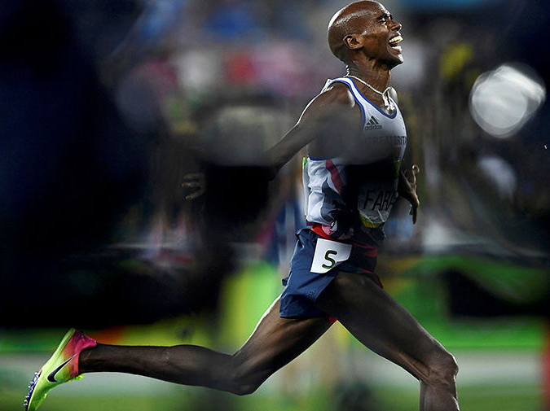
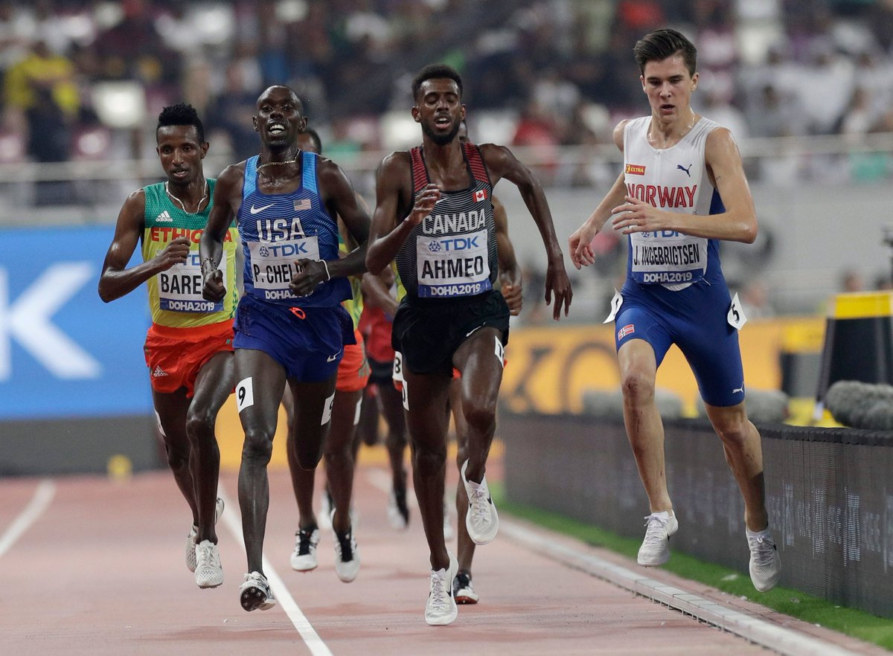
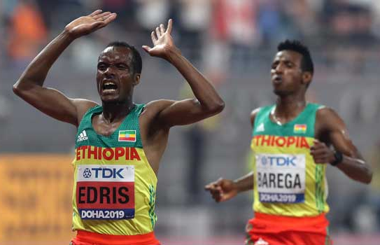
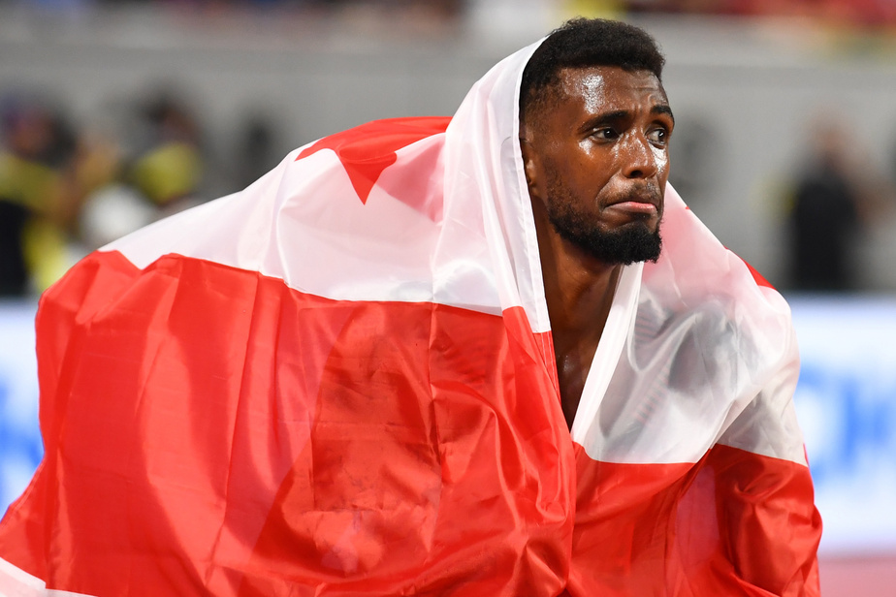
Бег 5000 м. (МУЖ)

Slide 24
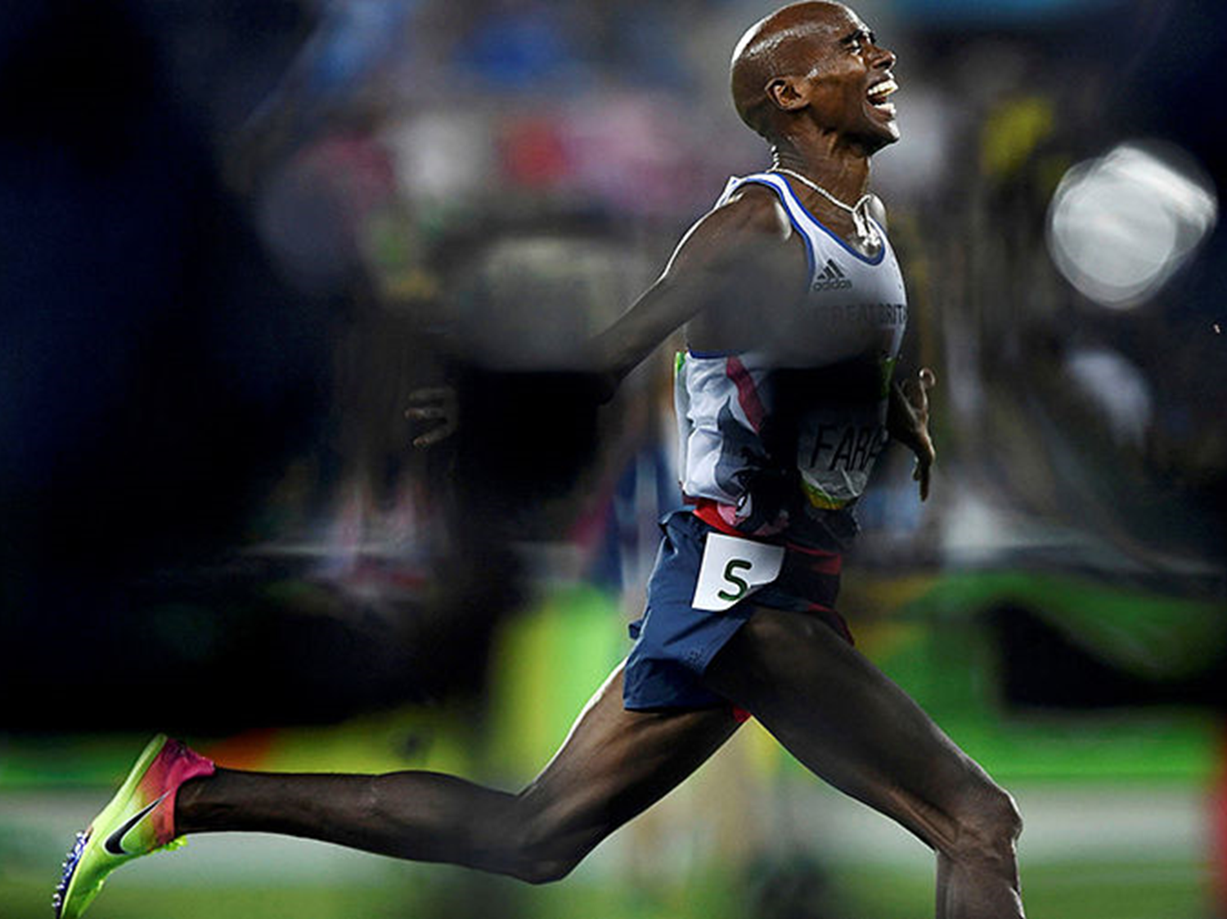
ТОП 10 результатов мира за все время:
RANK | MARK | COMPETITOR | DOB | NAT | POS | VENUE | DATE | RESULTS SCORE
1 | 12:37.35 | Kenenisa BEKELE | 13 JUN 1982 | ETH | 1 | Blankers-Koen Stadion, Hengelo (NED) | 31 MAY 2004 | 1294
2 | 12:39.36 | Haile GEBRSELASSIE | 18 APR 1973 | ETH | 1 | Helsinki (FIN) | 13 JUN 1998 | 1286
3 | 12:39.74 | Daniel KOMEN | 17 MAY 1976 | KEN | 1 | Bruxelles (BEL) | 22 AUG 1997 | 1285
4 | 12:43.02 | Selemon BAREGA | 20 JAN 2000 | ETH | 1 | Boudewijnstadion, Bruxelles (BEL) | 31 AUG 2018 | 1273
5 | 12:45.82 | Hagos GEBRHIWET | 11 MAY 1994 | ETH | 2 | Boudewijnstadion, Bruxelles (BEL) | 31 AUG 2018 | 1262
6 | 12:46.53 | Eliud KIPCHOGE | 05 NOV 1984 | KEN | 1 | Stadio Olimpico, Roma (ITA) | 02 JUL 2004 | 1259
7 | 12:46.79 | Yomif KEJELCHA | 01 AUG 1997 | ETH | 3 | Boudewijnstadion, Bruxelles (BEL) | 31 AUG 2018 | 1259
8 | 12:46.81 | Dejen GEBREMESKEL | 24NOV 1989 | ETH | 1 | Paris (FRA) | 06 JUL 2012 | 1258
9 | 12:47.04 | Sileshi SIHINE | 29 JAN 1983 | ETH | 2 | Stadio Olimpico, Roma (ITA) | 02 JUL 2004 | 1258
10 | 12:48.64 | Isiah Kiplangat KOECH | 19 DEC 1993 | KEN | 3 | Paris (FRA) | 06 JUL 2012 | 1252

Slide 25
ТОП 10 результатов в 2019г :
RANK | MARK | COMPETITOR | DOB | NAT | POS | VENUE | DATE | RESULTS SCORE
1 | 12:52.98 | Telahun Haile BEKELE | 13 MAY 1999 | ETH | 1 | Stadio Olimpico, Roma (ITA) | 06 JUN 2019 | 1235
2 | 12:53.04 | Selemon BAREGA | 20 JAN 2000 | ETH | 2 | Stadio Olimpico, Roma (ITA) | 06 JUN 2019 | 1235
3 | 12:54.92 | Hagos GEBRHIWET | 11 MAY 1994 | ETH | 3 | Stadio Olimpico, Roma (ITA) | 06 JUN 2019 | 1228
4 | 12:56.26 | Birhanu BALEW | 27 FEB 1996 | BRN | 4 | Stadio Olimpico, Roma (ITA) | 06 JUN 2019 | 1223
5 | 12:56.48 | Abadi HADIS | 06 NOV 1997 | ETH | 5 | Stadio Olimpico, Roma (ITA) | 06 JUN 2019 | 1223
6 | 12:57.41 | Joshua CHEPTEGEI | 12 SEP 1996 | UGA | 1 | Zürich (SUI) | 29 AUG 2019 | 1219
7 | 12:57.90 | Nicholas Kipkorir KIMELI | 29 SEP 1998 | KEN | 2 | Blankers-Koen Stadion, Hengelo (NED) | 09 JUN 2019 | 1217
8 | 12:58.10 | William KINCAID | 21 SEP 1992 | USA | 1 | Michael Jordan Track, Beaverton, OR (USA) | 10 SEP 2019 | 1217
9 | 12:58.16 | Mohammed AHMED | 05 JAN 1991 | CAN | 6 | Stadio Olimpico, Roma (ITA) | 06 JUN 2019 | 1216
10 | 12:58.85 | Muktar EDRIS | 14 JAN 1994 | ETH | 1f1 | Khalifa International Stadium, Doha (QAT) | 30 SEP 2019 | 1214

Slide 26
ТОП 10 результатов В БРИЛЛИАНТОВОЙ ЛИГЕ :
POS | ATHLETE | NAT | MARK | DATE
1 | Telahun Haile BEKELE | ETH | 12:52.98 | 06.06.2019
2 | Selemon BAREGA | ETH | 12:53.04 | 06.06.2019
3 | Hagos GEBRHIWET | ETH | 12:54.92 | 06.06.2019
4 | Birhanu BALEW | BRN | 12:56.26 | 06.06.2019
5 | Abadi HADIS | ETH | 12:56.48 | 06.06.2019
6 | Joshua CHEPTEGEI | UGA | 12:57.41 | 29.08.2019
8 | Mohammed AHMED | CAN | 12:58.16 | 06.06.2019
9 | Nicholas Kipkorir KIMELI | KEN | 12:59.05 | 29.08.2019
10 | Yomif KEJELCHA | ETH | 13:00.56 | 05.07.2019

Slide 27
ТОП 10 результатов финала Чемпионата мира 2019 г( 30.09.2019):
POS | BIB | ATHLETE | COUNTRY | MARK
1 | 700 | Muktar EDRIS | ETH | 12:58.85 SB
2 | 695 | Selemon BAREGA | ETH | 12:59.70
3 | 394 | Mohammed AHMED | CAN | 13:01.11
4 | 696 | Telahun Haile BEKELE | ETH | 13:02.29
5 | 1486 | Jakob INGEBRIGTSEN | NOR | 13:02.93
6 | 1290 | Jacob KROP | KEN | 13:03.08 PB
7 | 1873 | Paul CHELIMO | USA | 13:04.60 SB
8 | 1280 | Nicholas Kipkorir KIMELI | KEN | 13:05.27
9 | 361 | Birhanu BALEW | BRN | 13:14.66
10 | 407 | Justyn KNIGHT | CAN | 13:26.63
11 | 1918 | Hassan MEAD | USA | 13:27.05
12 | 170 | Stewart MCSWEYN | AUS | 13:30.41
13 | 1485 | Henrik INGEBRIGTSEN | NOR | 13:36.25
14 | 250 | Isaac KIMELI | BEL | 13:44.29
 | 1484 | Filip INGEBRIGTSEN | NOR | DNF

Slide 28
Динамика индивидуальных результатов сильнейших спортсменов в олимпийском цикле (главные старты):
Рисунок 1 – Муктар Эдрис (Эфиопия)
Рисунок 2 – Селемон Барега (Эфиопия)

Slide 29
Рисунок 3 – Мохаммед Ахмед (Канада)

Slide 30
Спасибо за внимание.

